Slide 1
Compliance and Improvement Monitoring (CIM) Targeted CIM Step 2 Training for the Targeted 2024 Cohort LEAs Focused Monitoring and Technical Assistance (FMTA) Units II and III

Slide 2
Reminders
The slides for this presentation will be emailed out to all participants
This webinar will be recorded and available on the CalTAN website
Please enter your questions in the Q and A. Frequently Asked Questions (FAQ) for this webinar will be available on the CalTAN Monitoring website
All participants are muted, and we cannot unmute you

Slide 3
FMTA Unit II
Lynne Boone
Education Programs Consultant
David Grundon
Education Programs Consultant
Donna DeMartini
Education Administrator
Kari Hudson
Education Programs Consultant
Jasmine Lee
Associate Governmental Program Analyst
Chee Lor
Office
Technician
Tamara McMillan
Education Programs Consultant
Kevin Simas
Education Programs Consultant
Jacqueline Stewart
Education Programs
Consultant
Vincent Pastorino Education Programs Consultant

Slide 4
FMTA Unit III
James T. Johnson, III
Education
Administrator
D’Andrea Chapman Education Programs Consultant
Vanessa Espinosa
Education Programs Assistant
Jeanette Acrell-Dunn
Associate Governmental Program Analyst
Libbey Durkee Education Programs Consultant
Nicole Garibaldi Education Programs Consultant

Slide 5
Participants
This training is for your LEA if both of the following apply…
Identified in the March 2024 Annual Determination Letter (ADL) notification as Targeted Level 1, 2, or 3
AND
2. Do not have an approved CIM or CCEIS Plan from the 2022 or 2023 monitoring year (i.e., 2022 or 2023 CIM Cohort)

Slide 6
Agenda
CIM Timeline for Targeted LEAs
CIM Step 2 Overview
Purpose of Root Cause Analysis
Instructions for Root Cause Analysis
Prepare for Root Cause Analysis
Conduct the Root Cause Analysis
Prioritize Root Causes
Assess the Identified Root Causes
How to Document Completion of Prioritization* and Root Cause Analysis
Next Steps and Questions
CDE FMTA Consultant Regional Map

Slide 7
CIM Timeline for LEAs in Targeted Monitoring
2025-2026
March 2024
April/May 2024
June/July 2024
August 2024
Sept/Oct 2024
Nov/Dec 2024
Read and Understand Annual Determination Letter
Contact SELPA and CDE Consultant as needed
Identify CIM Team
Begin Gathering and Analyzing Local Data
Attend CIM Step 1, Part 1 Training: Data Drill Down, Parent Input, Consolidation
Watch the pre-recorded PPPR training, available early April
Meet regularly with CIM Team
Upload data reports to SIL IDC
Complete Data Drill Down and Data Analysis
Gather and Analyze Parent Input
Work on PPPR
View CIM Step 2 training
Conduct Root Cause Analysis and Prioritization
Continue gathering and analyzing data as you uncover the “Why”
Work on the Root Cause Analysis
December 6, 2024
CIM Step 3 Due
CIM Step 3- CIM Plan
Assurances Form from SELPA for Level 1 and 2 LEAs are due to CDE by December 16, 2024.
July 10, 2024
CIM Step 1 Due
CIM Team
Data Drill Down
Identification of Problem Statements
Parent Input
PPPR due June 30, 2024
Consolidation
October 10, 2024
CIM Step 2 Due
Root Cause Analysis (Identification of Root Causes)
CIM Step 4
Attend CIM Step 4 Training: Progress Reporting
Implement and Monitor Plan
Submit Progress Reports
PPPR for disproportionate LEAs
Attend CIM Step 3 Training: CIM Plan Development (Oct)

Slide 8
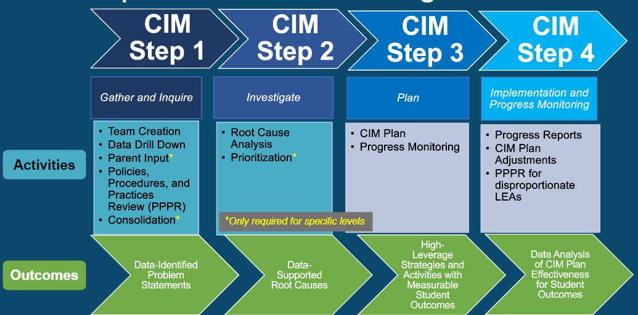
CIM Step 2 Overview
Prioritization of Problems*
Root Cause Analysis
*Only required for Targeted Level 3 LEAs
Outcome
Data-Supported
Root Cause(s)

Slide 9
Purpose of Root Cause Analysis
A root cause is a fundamental or core issue underlying the data-supported and quantified problem(s) identified at the end of CIM Step 1.
The purpose of root cause analysis is to identify, through, data analysis, the direct and indirect causes of the identified problem(s).
In CIM Step 3, the CIM Plan will be developed to eliminate or substantially reduce the impact of the root causes and improve outcomes for students with disabilities.

Slide 10
Instructions for Root Cause Analysis
Prepare for Root Cause Analysis
Review the data-supported problem areas from CIM Step 1
Targeted Level 3 LEAs need to prioritize their problem areas
Conduct the Root Cause Analysis
If not completed in CIM Step 1, please write clearly defined problem statements that are quantified and supported by data.
Document the data and findings that support your problem statement(s).
Identify methods (e.g., inquiry cycles, empathy interviews, process mapping, 5 Whys, Fishbone, etc. ) to gather information and analyze data that will uncover the causes of the problem(s).
You may use resources such as the Root Cause Analysis Plan or Root Cause Analysis Inquiry Guide. Many other resources are linked the in the Root Cause Analysis Activity Handout.
Summarize the findings.
Prioritize Root Causes
Required for Targeted Level 3

Slide 11
Prepare for Root Cause Analysis
Review the data-supported problem areas from CIM Step 1
The problem statement(s) need to include data gathered and analyzed from the data drill down in CIM Step 1.
The problem statement(s) need to be directly related to the indicators/unmet targets or rankings from the data sheets provided with the Annual Determination Letter.
Example: 71% of students with disabilities with a qualifying disability of SLD who identify as Hispanic/Latinx are EL and in 3rd-5th grade in 2024-25. 67% of these students did not receive adequate EL support during their 2nd grade year.

Slide 12
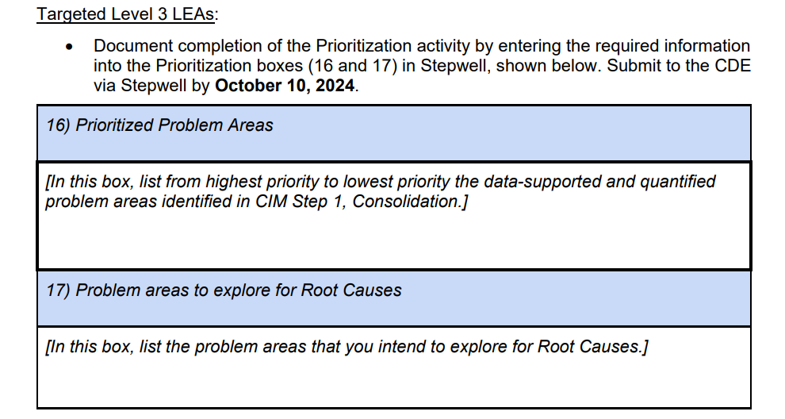
Prepare for Root Cause Analysis
Targeted Level 3 LEAs need to prioritize their problem areas
This activity is required for Targeted Level 3 LEAs and optional for Targeted Level 1 and 2 LEAs. This activity will be documented in Stepwell.
Prioritization Protocol

Slide 13
Conduct the Root Cause Analysis
Assemble your CIM Team to further gather and analyze data to uncover the causes of the identified problem statement(s).
Start with the problem statement(s)
If not completed in CIM Step 1, please write clearly defined problem statements that are quantified and supported by data.
Document the data and findings that support your problem statement(s)
The CIM Team should pose questions relating to the cause(s) of each problem.
Identify methods (e.g., inquiry cycles, empathy interviews, process mapping, 5 Whys, Fishbone, etc. ) to gather and review additional data that will uncover the causes of the problem(s).
You may use resources such as the Root Cause Analysis Plan or Root Cause Analysis Inquiry Guide. Many other resources are linked the in Root Cause Analysis Activity Handout.
Summarize the findings
This can be done using the Root Cause Analysis Plan

Slide 14
Prioritize Root Causes
Required for Targeted Level 3 LEAs
Focus on addressing the most important root cause(s) first. The Identify 1-3 prioritized root causes.
To help structure prioritization of root causes, the team may use any of the following resources:
Prioritization Protocol

Slide 15
Assess the Identified Root Causes
Have we identified at least 1 root cause and no more than 3?
If more than 3 root causes are identified, you will need to prioritize and/or consolidate the root causes.
Are the root causes related to the areas of concern and identified data-supported problem statements from CIM Step 1?
Are the root causes supported by qualitative and quantitative data?
Can the root causes be realistically addressed by the LEA in two years?
Are the root causes unbiased and free of blame on people or groups?

Slide 16
How to Document Completion Prioritization* and Root Cause Analysis
Due Date: October 10, 2024
Targeted Level 1 and 2 LEAs: Required, Submit to SELPA
How to Document Completion of Root Cause Analysis
Targeted Level 3 LEAs: Required, Submit in Stepwell
How to Document Completion of Prioritization
How to Document Completion of Root Cause Analysis

Slide 17
Next Steps
Review data-supported problem statements and data from CIM Step 1
Meet as a CIM Team to conduct root cause analysis
Contact your CDE consultant with any questions, concerns, or need for clarification
Click HERE to Register for CIM Step 3 Training on October 16, 2024, from 10am-12pm

Slide 18
Questions
Notes:
For individual questions and for more information, contact your CDE Consultant.

Slide 20
Thank you for your time and participation.

