Slide 1
Compliance and Improvement Monitoring (CIM) Targeted CIM Step 1 Training for the 2024 Cohort LEAs Focused Monitoring and Technical Assistance (FMTA) Units II and III
Notes:
•Welcome
•Introductions
•Myself, Donna, and Jackie
Lynne and Libbey will be answering questions

Slide 2
Reminders
The slides for this presentation will be emailed out to all participants.
This webinar will be recorded and available on the CalTAN website
Please enter your questions in the Q and A. Frequently Asked Questions (FAQ) for this webinar will be available on the CalTAN Monitoring website
All participants are muted, and we cannot unmute you.
Notes:
Just a few reminders:
•We will be sending out the presentation it will also be posted on the CalTAN website
•Use the Q and A for questions

Slide 3
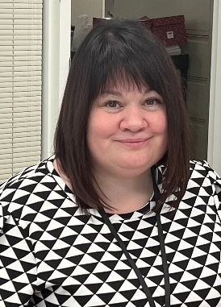
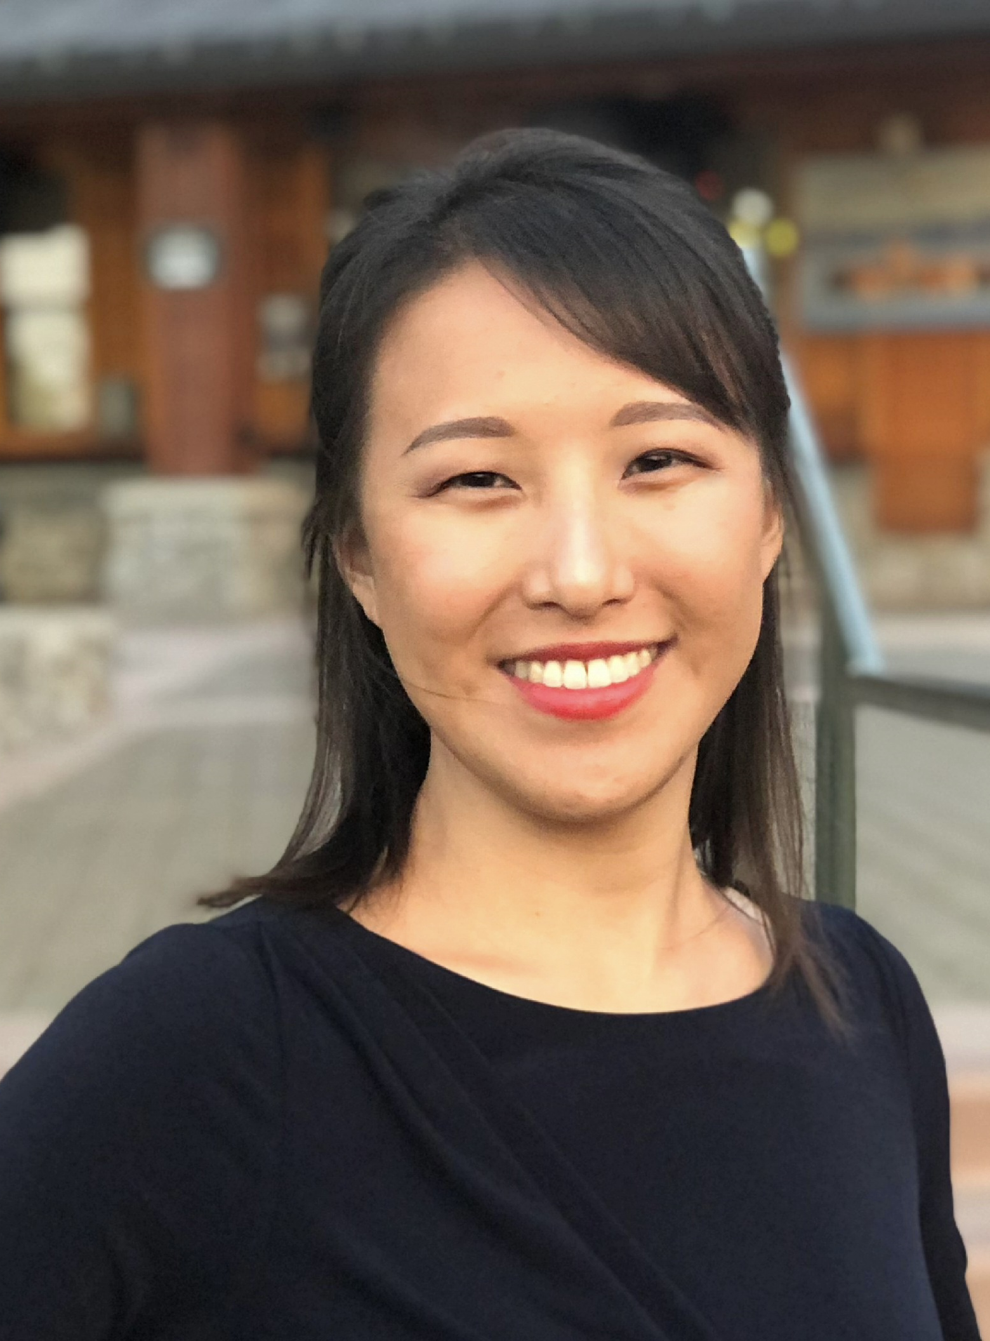
FMTA Unit II
Lynne Boone
Education Programs Consultant
David Grundon
Education Programs Consultant
Donna DeMartini
Education Administrator
Kari Hudson
Education Programs Consultant
Jasmine Lee
Associate Governmental Program Analyst
Chee Lor
Office
Technician
Tamara McMillan
Education Programs Consultant
Kevin Simas
Education Programs Consultant
Jacqueline Stewart
Education Programs Assistant
Vincent Pastorino Education Programs Consultant
Notes:
Lynne Boone – LAUSD and LACOE charters, David Grundon – Region 4, Donna DeMartini – Administrator, Kari Hudson – Region 3, Jasmine Lee – AGPA, Chee Lor-Office Technician, Myself – Region 11, Kevin Simas – Region 6, Jacqueline Stewart – Region 9, Vincent Pastorino – El Dorado County Charter SELPA

Slide 4
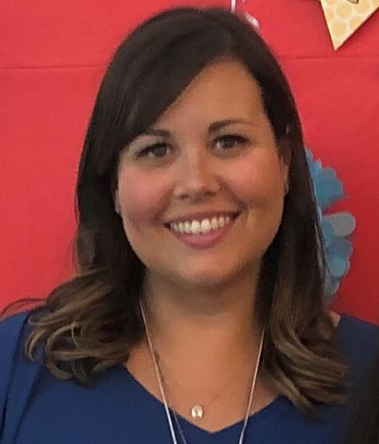
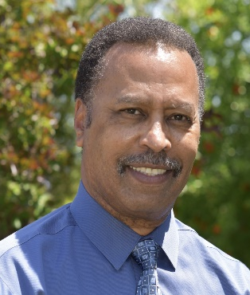
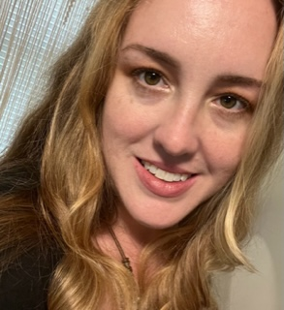
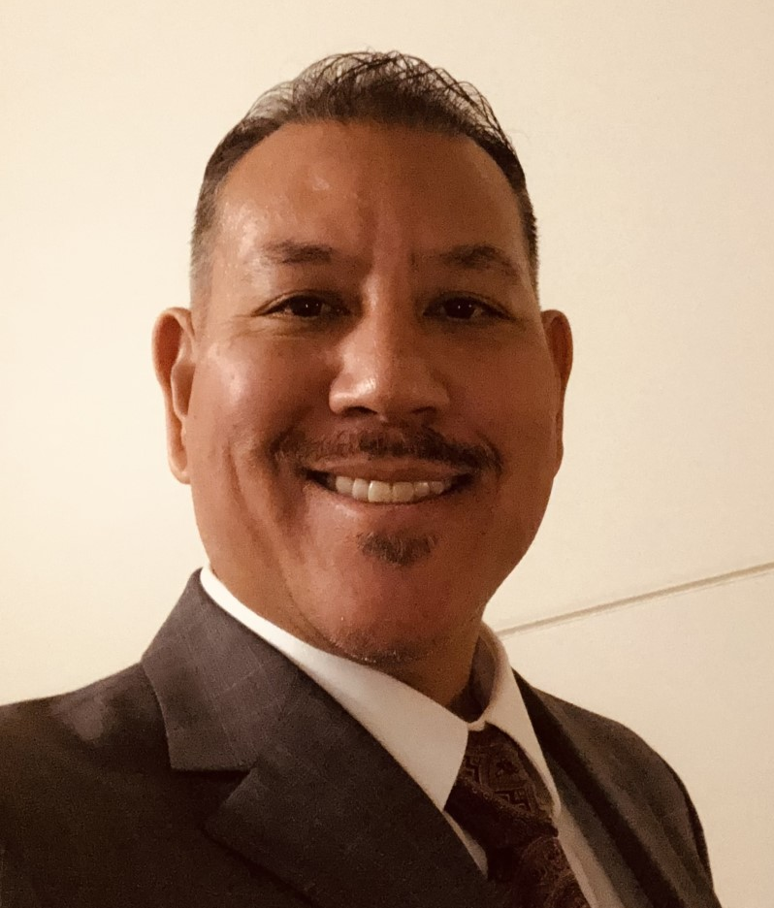
FMTA Unit III
D’Andrea Chapman Education Programs Consultant
Vanessa Espinosa
Education Programs Assistant
Jeanette Acrell-Dunn Associate Governmental Program Analyst
James T. Johnson, III
Education
Administrator
Nicole Garibaldi Education Programs Consultant
Libbey Durkee Education Programs Consultant
Jeffrey Reyes Education Programs Consultant
Notes:
D’Andrea Chapman – Regions 2 and 7, Vanessa Espinosa – Region 10, Janette Acrell-Dunn – AGPA, James Johnson – Administrator, Nicole Garibaldi – Region 8, Libbey Durkee – Region 5, Jeffrey Reyes – Region 1

Slide 5
Participants
This training is for your LEA if both of the following apply…
Identified in the March 2024 Annual Determination Letter (ADL) notification as Targeted Level 1, 2, or 3
AND
2. Do not have an approved CIM or CCEIS Plan from the 2022 or 2023 monitoring year (i.e., 2022 or 2023 CIM Cohort)

Slide 6
Agenda
CIM Timeline for Targeted LEAs
CIM Step 1 Overview
CIM Team Creation
Parent Input
PPPR
IDC CALPADs Reports Upload
Data Drilldown
Problem Statements
Consolidation
Next Steps
CDE FMTA Consultant Regional Map

Slide 7
CIM Timeline for LEAs in Targeted Monitoring
2025-2026
March 2024
April/May 2024
June/July 2024
August 2024
Sept/Oct 2024
Nov/Dec 2024
Read and Understand Annual Determination Letter
Contact SELPA and CDE Consultant as needed
Identify CIM Team
Begin Gathering and Analyzing Local Data
Attend CIM Step 1, Part 1 Training: Data Drill Down, Parent Input, Consolidation
Watch the pre-recorded PPPR training, available early April
Meet regularly with CIM Team
Upload data reports to SIL IDC
Complete Data Drill Down and Data Analysis
Gather and Analyze Parent Input
Work on PPPR
Attend CIM Step 2 Training: Root Cause Analysis and Prioritization
Continue gathering and analyzing data as you uncover the “Why”
Work on the Root Cause Analysis
December 6, 2024
CIM Step 3 Due
CIM Step 3- CIM Plan
Assurances Form from SELPA for Level 1 and 2 LEAs are due to CDE by December 17, 2024.
July 10, 2024
CIM Step 1 Due
CIM Team
Data Drill Down
Identification of Problem Statements
Parent Input
PPPR due June 30, 2024
Consolidation
October 10, 2024
CIM Step 2 Due
Root Cause Analysis (Identification of Root Causes)
CIM Step 4
Attend CIM Step 4 Training: Progress Reporting
Implement and Monitor Plan
Submit Progress Reports
PPPR for disproportionate LEAs
Attend CIM Step 3 Training: CIM Plan Development (Oct)
Notes:
Here is a timeline for the whole CIM process. As you can see Step 1 is due July 10

Slide 8
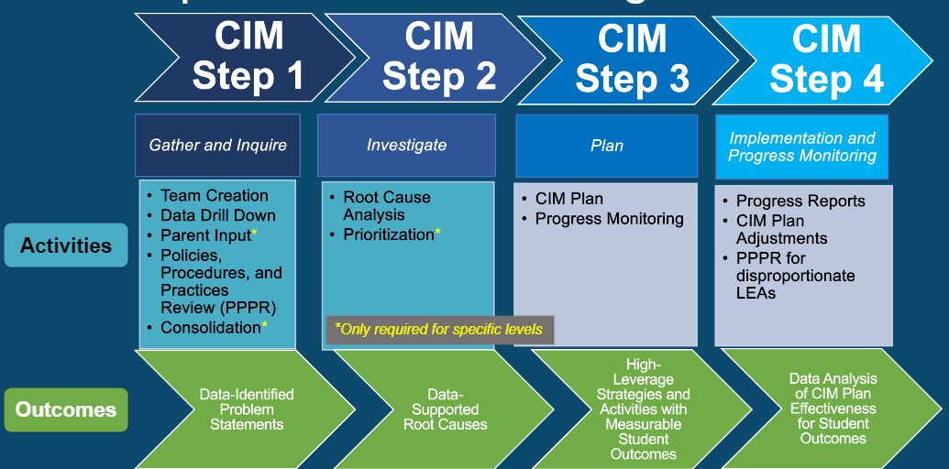
CIM Step 1 Overview
Team Creation
IDC CALPADs Reports Upload
Parent Input*
PPPR
Data Drill Down
Consolidation*
*Only required for specific levels, please see slides for specific activities later in the presentation
Outcome
Data-Supported Problem Statements
Notes:
So, what is due on July 10:
•Uploading CALPADs Reports to the IDC
•Parent input data if applicable
•PPPR – Actually due June 30th
•Data Drill Down
Consolidation Activity – if applicable

Slide 9
Required CIM Team Members for Targeted LEAs
Superintendent or designee
LEA general education administrator
LEA special education administrator
Site-level administrator
SELPA representative
Optional Targeted CIM Team Members: additional administrators, teachers, parents, and/or community members.
If your LEA is smaller, one person may be holding dual roles. In this case, the LEA needs to consult with their SELPA and CDE consultant by April 30th, 2024.
The CIM Team will meet regularly to discuss and complete the CIM work together beginning in Step 1 and throughout Step 4.
Notes:
You should have already been working on getting your team together. Just as a reminder you need to have the following representatives on your team: Superintendent or designee, general and special education district administrators, a site administrator and a representative from SELPA. If you are a small district and need to have one person hold dual roles you need to consult with both your SELPA and CDE Consultant by April 30th.

Slide 10
Considerations for CIM Team Development
At least one CIM Team member needs to have access to data
The CIM Team Leader’s responsibilities may include the following:
Schedule and facilitate regular meetings and/or trainings throughout the CIM development and CIM Plan Implementation (2024-2026).
Serve as the point-of-contact for the CIM Team’s SELPA representative, the CIM Team members, the LEA’s cabinet, and the LEA’s superintendent, as needed.
Keep a record of all documentation for CIM Steps 1, 2, 3, and 4.
Seek technical assistance as needed from SELPA and/or the LEA’s CDE consultant.
Consider the involvement of additional team members whose expertise or knowledge would benefit the CIM process.
Notes:
There should be one person that is designated as the CIM Team Leader. This person will schedule meetings, serve as point of contact for SELPA and CDE, and keep the documentation handy and organized.

Slide 11
Documenting Completion of Team Creation
Due Date: July 10, 2024
Targeted Level 1 and 2 LEAs
How to Document Completion of Team Creation to SELPA
Targeted Level 3 LEAs
How to Document Completion of Team Creation in Stepwell

Slide 12
Questions
Notes:
For individual questions and for more information, contact your CDE Consultant.

Slide 13
Types of Parent Input
Required for
Targeted Levels 1 and 2 LEAs if Indicator 8- Parent Involvement not met
All Targeted Level 3 LEAs
Parent Input Meetings
Empathy Interviews
Suggestion Box
Parent Surveys
Seeds of Partnership
Information regarding Seeds of Partnership
Request Access Form
Notes:
You can use a variety of methods to collect parent input some we have listed here are parent input meetings, empathy interviews, suggestion box, and parent surveys. Speaking of parent surveys Seeds of Partnership is on the Technical Assistance Providers that we are paired up with. This is a great resource to complete this task if you need to do so. They have a great survey already developed and can help make a daunting task manageable.

Slide 14
Documenting Completion of Parent Input
Due Date: July 10, 2024
Targeted Level 1 and 2 LEAs that did not meet the target for
Indicator 8- Parent Involvement
How to Document Completion of Parent Input to SELPA
All Targeted Level 3 LEAs
How to Document Completion of Parent Input in Stepwell

Slide 15
Policies, Procedures, and Practices Review
Due Date: June 30, 2024
The CDE has posted a pre-recorded Policies, Procedures, and Practices Review (PPPR) training on the CalTAN Monitoring website.
All Targeted LEAs in the 2024 cohort must complete a Policies, Procedures, and Practices Review (PPPR) and view the pre-recorded training.
The pre-recorded PPPR training will include:
A timeline of the activity
Steps to complete the activity
Special Education Compliance Monitoring System screenshots (and an explanation of SECMS)
The PPPR will begin in April and will be due by June 30, 2024. If corrective actions are issued, corrections and Prong II could prolong the completion of the review into 2025.

Slide 16
Documenting Completion of the Policies, Procedures, and Practices Review (PPPR)
Due Date: July 10, 2024
Targeted Level 1 and 2 LEAs
How to Document Completion of the PPPR to SELPA
Targeted Level 3 LEAs
How to Document Completion of the PPPR in Stepwell
Notes:
You will finish the PPPR in SECMS. Here you will be documenting trends you observe and what was learned through this review process. This documentation will be completed and sent to your reviewing agency by July 10th. So, the actual review is due June 30th in SECMS and your reflection of the process is due July 10th.

Slide 17
Questions
Notes:
For individual questions and for more information, contact your CDE Consultant.

Slide 18
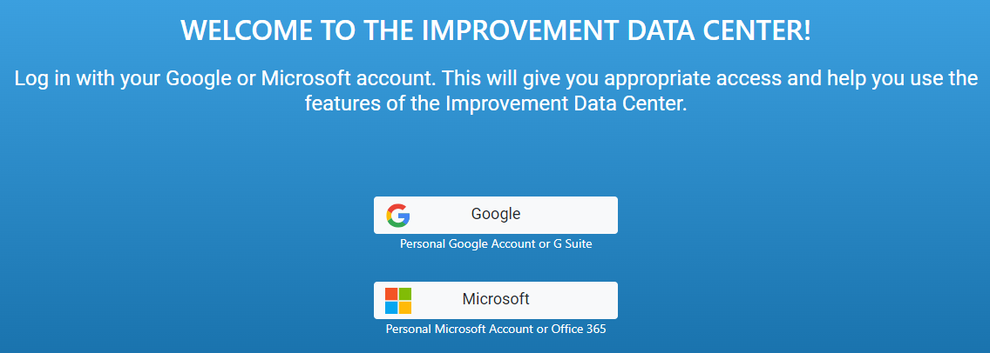
System Improvement Leads Improvement Data Center
Click here: System Improvement Leads (SIL)- Improvement Data Center(IDC)
First, sign in with a Google or Microsoft account.
Once logged in, choose your Reporting Level and your Organization from the drop-down menus.
Notes:
- Improvement Data Center (systemimprovement.org)

Slide 19
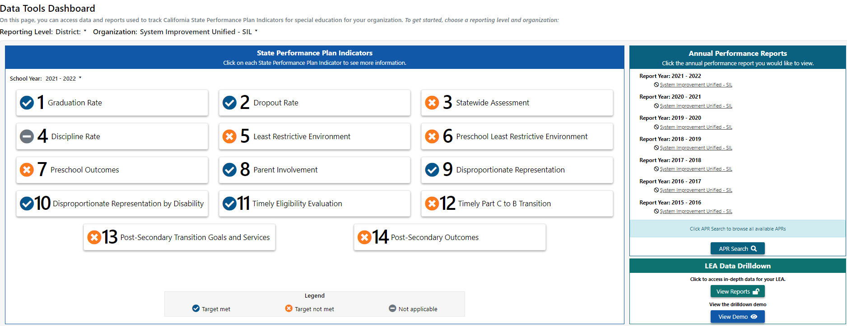
IDC- Data Tools Dashboard

Slide 20
IDC- Data Tools Dashboard
The Data Tools Dashboard page has three sections:
State Performance Plan Indicators (SPPIs)
Historical, public data for 14 Indicators
Smaller LEAs may notice they have many gray (-) N/A symbols. N/A means the calculation was not completed or is not released publicly because the group size is too small.
Optional Tool: Historical Data Protocol
Annual Performance Reports (APRs)
LEA Data Drilldown
Current Data, private to LEA only
Where you will upload your 9 CALPADs Reports

Slide 21
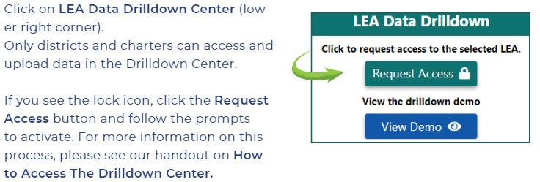
LEA Data Drilldown Center
Step-by-Step Guide on How to Access the Data Drill Down Center
Notes:
Speak about being the "admin" of the data drill down, granting others access. If there is already an admin- the request access button will email the current admin. Troubleshoot- contact SIL to reset account if people from LEA have left

Slide 22
CALPADs Reports Upload
Please use this guide: How to Upload CALPADs Reports to the SIL IDC- Data Drilldown Center.
This chart displays the 9 CALPADs reports you will need to upload to the IDC.
Work with your CALPADS administrator to locate and download these files
The file specifications can be found on the CALPADS System Documentation page and instructions for the CALPADS extract process can be found on the CAPADS User Manual site
For an expanded view of the chart above, please click here

Slide 23
Gathering Data- SIL LEA Snapshot Reports
Disproportionality
Least Restrictive Environment
Discipline Rate
Post-secondary Transition Goals
Preschool Least Restrictive Environment
Timely Eligibility Evaluation
Parent Involvement
SIL Data Drilldown Resources
How to Interpret the LEA Snapshot Reports
LEA Snapshot Protocol

Slide 24
Gathering Data- Local Data
Parent Input Data
PPPR Data
Graduation and Dropout Rates
ELA /Math Achievement
Program/Placement Options
Site Visits
Staff Interviews
Unit Test Scores
Assessment Information
Progress on IEP Goals
SST Records
Discipline Records

Slide 25
Data Drilldown Process
The Data Drilldown consists of three main tasks:
Identify and understand the Areas of Concern
Identify the Target Student Group
Identify the Problem Statements

Slide 26
Identifying the Areas of Concern
Start with the data sheets provided by the CDE
Targeted Level 1 and 2 LEAs
Focus on unmet targets on Targeted Review Data Sheet
Targeted Level 3 LEAs
Focus on indicators with a rank of 5 and below on the School Age or Preschool Intensive Review Data Sheets
Review unmet targets on Targeted Review Data Sheet
In addition, LEAs with Disproportionality Data Sheets need to focus on specific areas of disproportionality
Learn about each specific indicator
What is it measuring
SPPI Guide
Gather Data Related to Areas of Concern
Utilize district, site, and student level data

Slide 27
Areas of Concern Example
Indicator/Target | Area of Concern
Indicator 9: Disproportionality Overall – 8.20 African American | Students who identify as African American are 8.20x more likely to be qualified for Special Education than other students.
ELA/Math Performance | Students with disabilities in 4th and 5th grade across all school sites are performing an average of 50 points below their peers without identified disabilities on the SBAC exams. These students are also performing 23% lower on ELA/Math district unit benchmark exams.

Slide 28
Identifying the Target Student Group
Identify students who have been impacted by each Area of Concern
Gather data on these students pertaining to the Areas of Concern
Drilldown further
What has been the educational experience for the students
Interventions, supports, placement, discipline, home language, socioeconomic factors, foster youth/homeless, years in SPED, any other commonalities
Student | School | Grade | Qualifying Disability | Race/ Ethnicity | Benchmark Scores | SBAC scores (Is this above or below student average for LEA)
Matthew Paschke | Daniels Elementary | 5 | SLD | White | 2 | 198- below
Zeke McMillan | Heather Elementary | 4 | ED | Hispanic | 2 | 210-below

Slide 29
Data-Supported Quantified Problem Statements
Develop one or more problem statements
A good problem statement has the following qualities
It is student-centered
It is directly connected to the Indicators/unmet targets that need to be addressed
It uses data to state the problem or situation
It can be understood by those in and outside the LEA without additional explanation

Slide 30
Examples of Data-Supported Quantified Problem Statements
Area of Concern | Problem Statements
Least Restrictive Environment (LRE) | Students with disabilities who are in the regular classroom 41%-79% are enrolled in a support class every semester from 6th-12th grade. Only 12% of these students have one class outside of the general education environment (which would be over the 80% threshold). The Empathy Interviews reveal that this required class may not be needed all the time.
ELA/Math Academic Performance | 28% of students with Disabilities who did not meet standards on the SBAC assessment were not reading at grade level and did not receive any intervention or supplemental instruction prior to the test.
Behavior Challenges/ Suspension | 92% of the Target Student Group (students with disabilities who have been suspended more than once in 2023-2024) did not address the reason they were suspended in their IEP meeting or an addendum. 78% of these students either did not have a BIP or behavior goal or the behavior was not addressed in the BIP or behavior goal.

Slide 31
Data Drilldown
Due Date: July 10, 2024
Targeted Level 1 and 2 LEAs
How to Document Completion of the Data Drilldown to SELPA
Targeted Level 3 LEAs
How to Document Completion of the Data Drilldown in Stepwell

Slide 32
Questions
Notes:
For individual questions and for more information, contact your CDE Consultant.

Slide 33
Consolidation
Required for
All Targeted Level 3 LEAs
Optional for
Targeted Levels 1 and 2
The purpose of consolidation is to synthesize the wide range of quantitative and qualitative data collected through Step 1 activities into overall areas of LEA strengths and weaknesses.
Consolidation Activity Handout
SIL Consolidation Video
Affinity Protocol
Notes:
Consolidation is a required activity for Targeted Level 3 LEAs. It is an optional activity for Targeted Levels 1 and 2.

Slide 34
Documenting Completion of Consolidation
Due Date: July 10, 2024
Targeted Level 1 and 2 LEAs
Optional
Targeted Level 3 LEAs - Required
How to Document Completion of Consolidation in Stepwell

Slide 35
Next Steps (1 of 2)
Identify your CIM Team Members
Establish a system to maintain up-to-date documentation throughout the CIM process
Complete the CALPADs Reports Upload Process to the System Improvement Leads (SIL) Improvement Data Center (IDC)
Collect, Review, and Analyze all data related to the unmet indicators and/or low ranks on the data sheets provided by the CDE in the Annual Determination Letter. Conduct a Data Drill Down to Identify Data-supported and Quantified Problem Statements. Targeted Level 3 LEAs will consolidate data before identifying Problem Statements.
Identify and begin to develop a method for collecting Parent Input. *If using Seeds of Partnership for Parent Input, LEAs need to create a primary user account by filling out a Request for Access Form

Slide 36
Next Steps (2 of 2)
Watch the pre-recorded Policies, Procedures, and Practices (PPPR) training. Complete and submit the PPPR in the Special Education Compliance and Monitoring System (SECMS) by June 30, 2024.
Targeted Level 3 LEAs : Submit CIM Step 1 in the Stepwell online system by July 10, 2024.
Targeted Level 1 and 2 LEAs: Submit CIM Step 1 to SELPA by July 10, 2024
Contact your CDE Consultant with any questions, concerns, or needs for clarification and watch for emails
Registration Information for the Targeted CIM Step 2 Training will be emailed out to you when it is available. Tentatively scheduled for August 2024.

Slide 37
CDE FMTA Consultant Map and Contact Information by Region
FMTA II Administrator Donna DeMartini ddemartini@cde.ca.gov | FMTA III Administrator James Johnson jamjohns@cde.ca.gov
Region 3 Kari Hudson khudson@cde.ca.gov | Region 1 Jeffrey Reyes jereyes@cde.ca.gov
El Dorado County Charter SELPA Vincent Pastorino vpastorino@cde.ca.gov Kevin Simas ksimas@cde.ca.gov | Region 2 and Region 7 D’Andrea Chapman dchapman@cde.ca.gov
Region 4 David Grundon dgrundon@cde.ca.gov | Region 5 Libbey Durkee Ldurkee@cde.ca.gov
Region 6 Kevin Simas ksimas@cde.ca.gov | Region 8 Nicole Garibaldi ngaribaldi@cde.ca.gov
Region 9 Jacqueline Stewart jstewart@cde.ca.gov | Region 10 Vanessa Espinosa vespinosa@cde.ca.gov
Region 11 Tamara McMillan TMcMillan@cde.ca.gov
LAUSD and LACOE Charters Lynne Boone Lboone@cde.ca.gov

Slide 38
Questions
Notes:
For individual questions and for more information, contact your CDE Consultant.

Slide 39
Thank you for your time and participation.

