Slide 1
Compliance and Improvement Monitoring (CIM)
Targeted Orientation for the 2024 Cohort LEAs
Focused Monitoring and Technical Assistance (FMTA) Units II and III

Slide 2
Reminders
This webinar will be recorded and available on the CalTAN website
Please enter your questions in the Q and A
All participants are muted, and we cannot unmute you

Slide 3
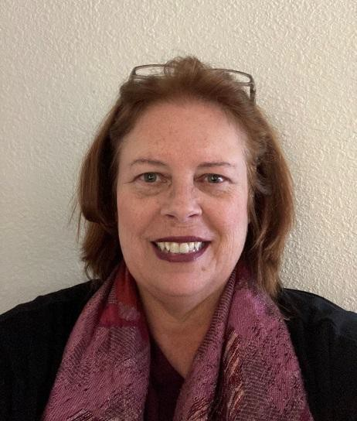

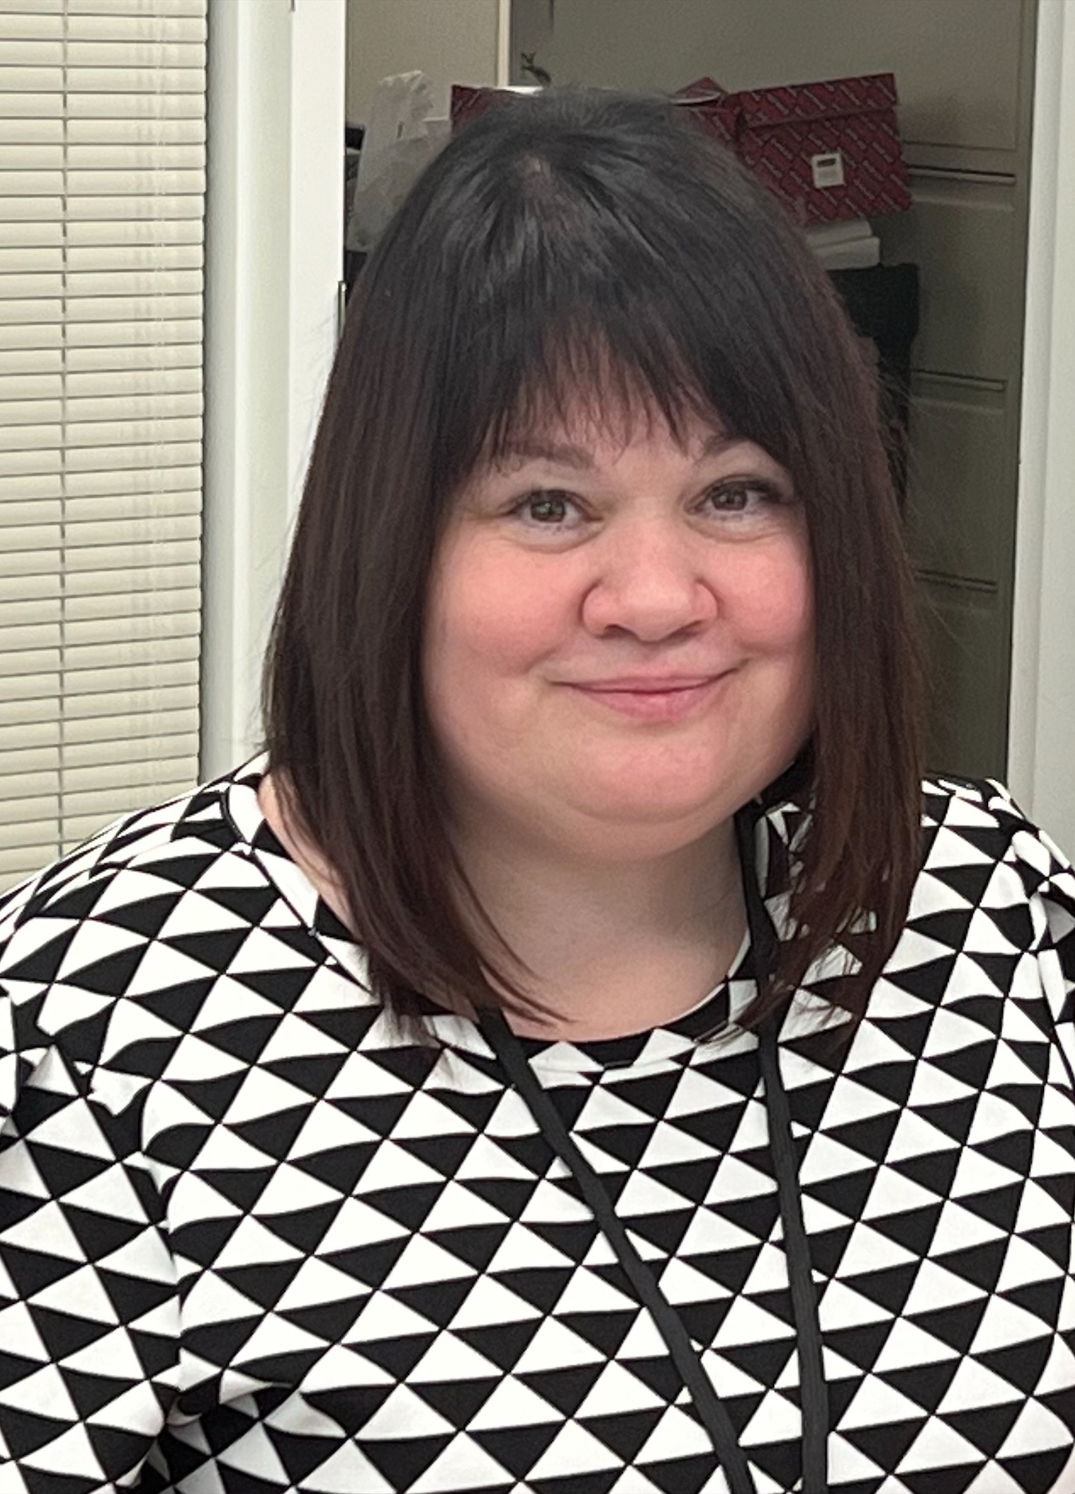




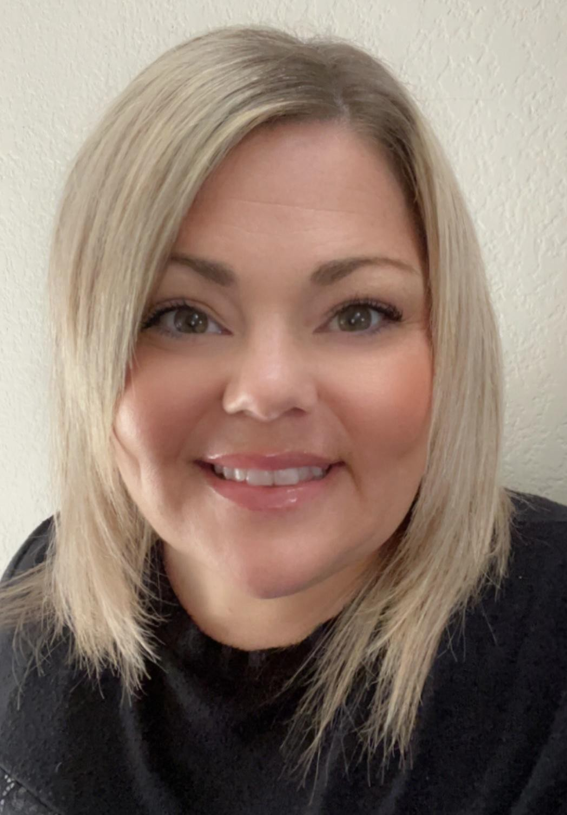
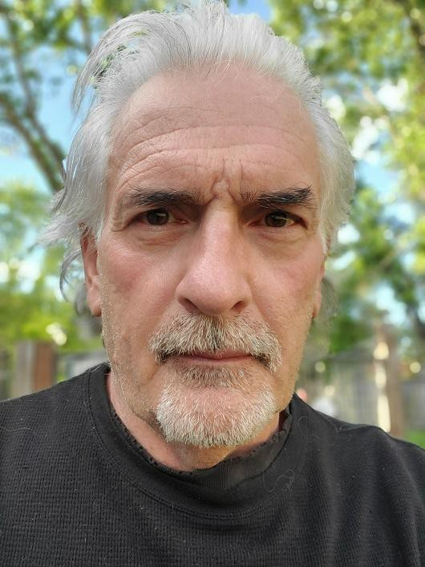
FMTA Unit II
Lynne Boone Education Programs Consultant
David Grundon
Education
Programs
Consultant
Kari Hudson
Education
Programs
Consultant
Jasmine Lee
Associate Governmental Program Analyst
Donna DeMartini
Education Administrator
Chee Lor
Office
Technician
Tamara McMillan Education Programs Consultant
Jacqueline Stewart Education Programs Assistant
Vincent Pastorino Education Programs Consultant

Slide 4

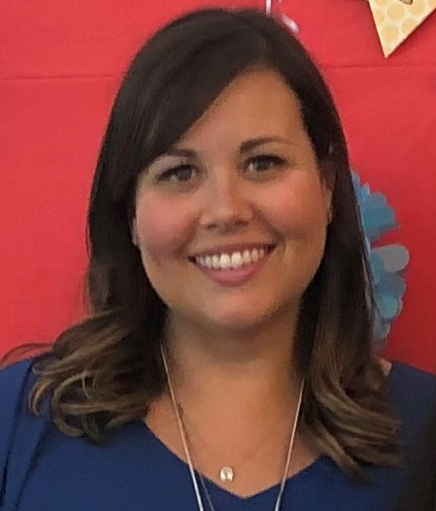

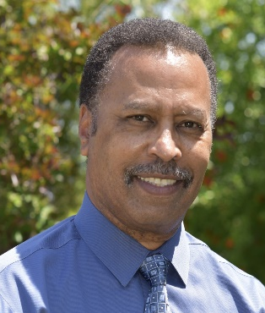


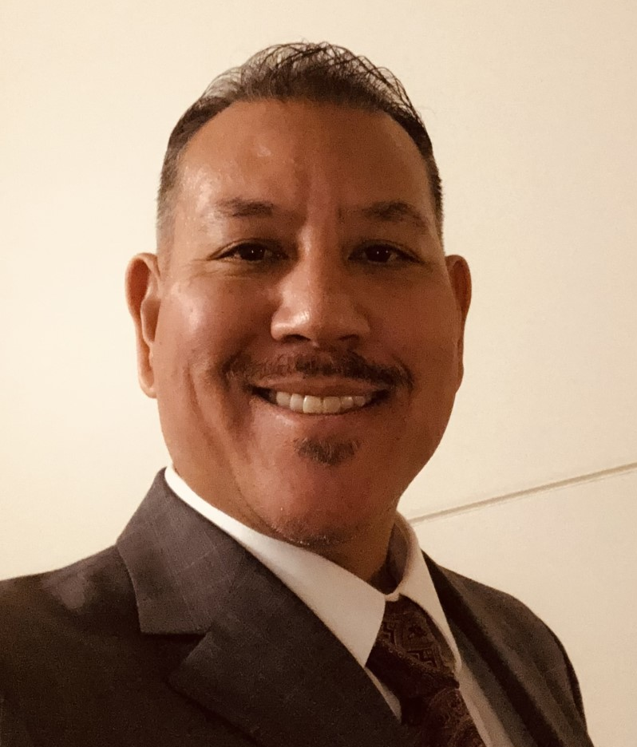
FMTA Unit III
D’Andrea Chapman Education Programs Consultant
Vanessa Espinosa
Education Programs Assistant
Jeanette Acrell-Dunn Associate Governmental Program Analyst
James T. Johnson, III
Education
Administrator
Nicole Garibaldi Education Programs Consultant
Libbey Durkee Education Programs Consultant
Jeffrey Reyes Education Programs Consultant

Slide 5
Agenda
Participants
The CIM Process and the 2024 Monitoring Year Overview
Annual Determination Letter
Targeted Tier Selection Criteria and Reviewing the Data Sheets
Questions and Answers
Required Activities and Timeline for Targeted LEAs in the 2024 Cohort
Required CIM Team Members for Targeted LEAs
Documentation
Policies, Procedures, and Practices Review (PPPR)
Roles of the Consultant and SELPA
Where to Find CIM Information
Next Steps
CDE FMTA Consultant Regional Map
Questions and Answers

Slide 6
Participants
This training is for your LEA if both of the following apply…
  Identified in the March 2024 Annual Determination Letter (ADL) notification as Targeted Level 1, 2, or 3
AND
2. Do not have an approved CIM or CCEIS Plan from the 2022 or 2023 monitoring year (i.e., 2022 or 2023 CIM Cohort)

Slide 7
Monitoring Tiers
Intensive
Targeted
Universal
Directive Support
Assistance Provided
Resources Available

Slide 8
The CIM Process
Year 1: 2024
Step 1- Gather and Inquire
Step 2- Investigate
Step 3- Plan
How can we address it?
What is occurring?
Why is this happening?
Step 4: Implementation and Progress Monitoring
Collect and Review Local Data Regularly
Is the CIM Plan improving student outcomes?
Implement CIM Activities and Track Progress
Year 2: 2025 and Year 3: 2026
Update Plan as Needed
What is working? What needs to be adjusted?

Slide 9
The 2024 Monitoring Year Starts Now
March
March-July
Gather and Inquire
October-November
Plan
July-September
Investigate
December 6, 2024
CIM Step 1
CIM Step 2
CIM Step 3
October 10, 2024
Step 3 CIM Plan Due
Step 2 Activities Due
June 30, 2024
Step 1 Activities Due
CIM Team
Orientation
Annual Determination Letter
PPPR due
July 10, 2024
For the 2024 Cohort
Gather and Inquire
Plan
Root Cause

Slide 10
Annual Determination Letter
Published on March 18, 2024
Includes Information on 3 Required Areas
  Monitoring Tier and Level and Annual Determination for 2024
  Timeline Compliance
  Official Significant Disproportionality Determination

Slide 11
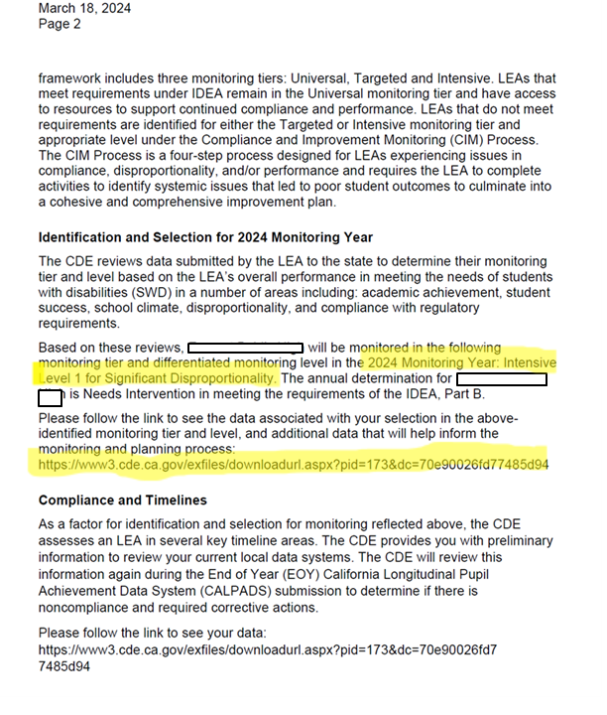
Annual Determination Letter
Description of Monitoring System
The Monitoring Tier and Level
& 2024 Annual Determination
An individual link to an LEA’s Data on how they were selected

Slide 12
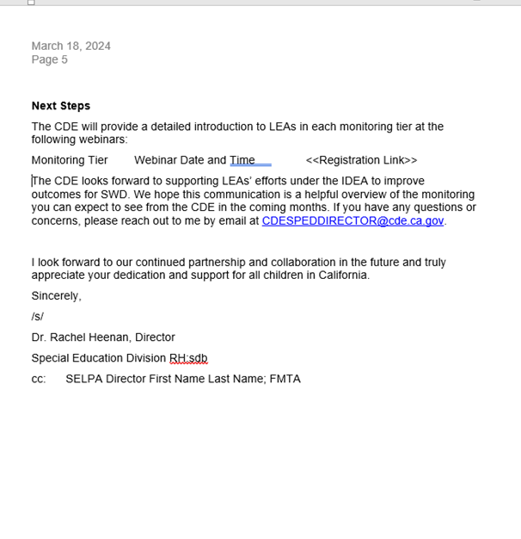
Annual Determination Letter

Slide 13
Targeted Tier Selection Criteria
Targeted Level 1
  Not meeting 1 or 2 Indicators on the Targeted Review Data Sheet
Targeted Level 2
  Not meeting 3 or more Indicators on the Targeted Review Data Sheet
    AND/OR
  First year of Disproportionality
Targeted Level 3
  2+ years of Disproportionality
    AND/OR
  Bottom 11-20% of the School Age Intensive Data Review or Preschool Intensive Review Data Sheets
    AND/OR
  Rank of 1 on the School Age Intensive Data Review or Preschool Intensive Review Data Sheets

Slide 14
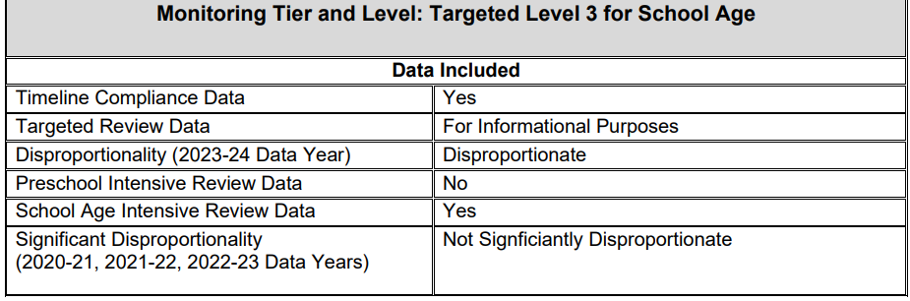
Reviewing the Data Sheets
A variety of data reviews are completed to determine an LEA’s monitoring tier and level.
The link provided on page 2 of the Annual Determination Letter will provide you with a chart (example below) that summarizes the reason for selection

Slide 15
Preschool Intensive Review Data

Slide 16
School Age Intensive Review Data

Slide 17
Targeted Review Data
Unmet
Targets

Slide 18
Disproportionality
LEAs identified as Disproportionate have one or more risk ratios above 3.0 on the Disproportionality Data Sheets.
Targeted, Level 1 | Targeted, Level 2 | Targeted, Level 3 | Intensive, Significant Disproportionality
Not Applicable | Year 1 of Disproportionality for a race/ethnicity in a Disproportionality Indicator (e.g., Hispanic SLD) | Year 2 or Year 3 of Disproportionality for the same race/ethnicity category and Disproportionality Indicator (e.g., Hispanic SLD) | More than 3 consecutive years of Disproportionality for the same race/ethnicity category and Disproportionality Indicator (e.g., Hispanic SLD)

Slide 19
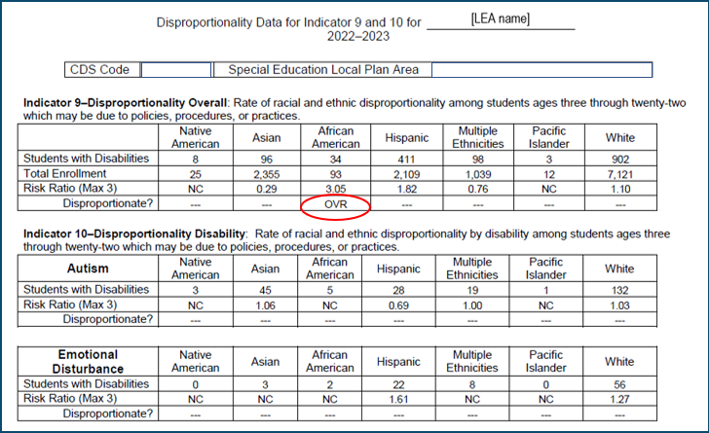
Disproportionality Data

Slide 20
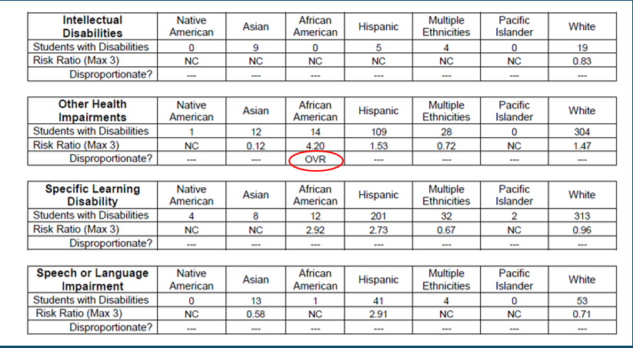
Disproportionality Data Page 2

Slide 21

Questions

Slide 22
Required Activities for Targeted LEAs
CIM Step 1
CIM Step 2
CIM Step 3
CIM Step 4
Gather and Inquire
Team Creation
Policies, Procedures, and Practices Review (PPPR)
Investigate
Root Cause Analysis
Prioritization*
Plan
CIM Plan
Implementation and Progress Monitoring
Data Drill Down
Parent Input*
Consolidation*
Progress Reports
CIM Plan Adjustments
Progress Monitoring
PPPR for disproportionate LEAs
Activities
Data-Identified Problem Statements
Data-Supported Root Causes
High-Leverage Strategies and Activities with Measurable Student Outcomes
Data Analysis of CIM Plan Effectiveness for Student Outcomes
*Only required for specific levels, see next slide
Outcomes

Slide 23
Required Activities by Targeted Level
All CIM activities listed on the previous slide are required for all Targeted LEAs in the 2024 CIM Cohort except for the following:
Parent Input
  Required for all Targeted Level 3 LEAs
  Required for any Targeted Level 1 and 2 LEAs that did not meet the target for Indicator 8- Parent Involvement on the Targeted Review Data Sheet
Consolidation
  Required for all Targeted Level 3 LEAs
  Highly recommended for all Targeted Level 1 and 2 LEAs
Prioritization
  Required for all Targeted Level 3 LEAs
  Highly recommended for all Targeted Level 1 and 2 LEAs

Slide 24
CIM Timeline for Targeted LEAs
2025-2026
March 2024
April/May 2024
June/July 2024
August 2024
Sept/Oct 2024
Nov/Dec 2024
Read and Understand Annual Determination Letter
Contact SELPA and CDE Consultant as needed
Identify CIM Team
Begin Gathering and Analyzing Local Data
Attend CIM Step 1, Part 1 Training: Data Drill Down, Parent Input, Consolidation
Watch the pre-recorded PPPR training, available early April
Meet regularly with CIM Team
Upload data reports to SIL IDC
Complete Data Drill Down and Data Analysis
Gather and Analyze Parent Input
Work on PPPR
Attend CIM Step 2 Training: Root Cause Analysis and Prioritization
Continue gathering and analyzing data as you uncover the “Why”
Work on the Root Cause Analysis
December 6, 2024
CIM Step 3 Due
CIM Step 3- CIM Plan
Assurances Form from SELPA for Level 1 and 2 LEAs are due to CDE by December 17, 2024.
July 10, 2024
CIM Step 1 Due
CIM Team
Data Drill Down
Parent Input
PPPR due June 30, 2024
Consolidation (Identification of Problem Statements)
October 10, 2024
CIM Step 2 Due
Root Cause Analysis (Identification of Root Causes)
CIM Step 4
Attend CIM Step 4 Training: Progress Reporting
Implement and Monitor Plan
Submit Progress Reports
PPPR for disproportionate LEAs
Attend CIM Step 3 Training: CIM Plan Development (Oct)

Slide 25
Required CIM Team Members for Targeted LEAs
Superintendent or designee
LEA general education administrator
LEA special education administrator
Site-level administrator
SELPA representative
  Optional Targeted CIM Team Members: additional administrators, teachers, parents, and/or community members.
If your LEA is smaller, one person may be holding dual roles. In this case, the LEA needs to meet with their CDE consultant.
The CIM Team will meet regularly to discuss and complete the CIM work together beginning in Step 1 and throughout Step 4.

Slide 26
Considerations for CIM Team Development
  At least one CIM Team member needs to have access to data
  The CIM Team Leader’s responsibilities may include the following:
      Schedule and facilitate regular meetings and/or trainings throughout the CIM development and CIM Plan Implementation (2024-2026).
      Serve as the point-of-contact for the CIM Team’s SELPA representative, the CIM Team members, the LEA’s cabinet, and the LEA’s superintendent, as needed.
      Keep a record of all documentation for CIM Steps 1, 2, 3, and 4.
      Seek technical assistance as needed from SELPA and/or the LEA’s CDE consultant.
      Consider the involvement of additional team members whose expertise or knowledge would benefit the CIM process.

Slide 27
Documentation
Each Targeted Level 1, 2, and 3 LEA must create and maintain organized documentation of its CIM Plan development, implementation and monitoring.
Documentation maintained by the LEA should include, but not be limited to, the following:
  CIM Team meeting notes
  Data collected and analyzed throughout the CIM process
  Copies of written communication pertinent to the CIM process, to or from the CDE
  A complete version of the current CIM Plan, including updates, integrated into a single document.
  (The LEA, SELPA, or CDE should not have to identify, find, and isolate pertinent portions of multiple documents to determine the current version of the LEA’s CIM Plan.)
  For purposes of reference or comparison, any earlier working versions of the CIM Plan

Slide 28
Documentation
Documentation tips:
For Targeted Level 1, 2, and 3 LEAs – be prepared that the SELPA and CDE may request supporting documentation at any time during the CIM process.
Within the supporting documentation, include notes explaining the CIM Team’s data-based rationale for any revisions to the CIM Plan. (This will be helpful to the CIM Team if the composition of the team changes.)
For Targeted Level 3 LEAs – keep backup copies of any required CIM documentation submitted to the CDE either directly or via an online program or database.

Slide 29
Policies, Procedures, and Practices Review
CDE will post a pre-recorded Policies, Procedures, and Practices Review (PPPR) training in early April.
All Targeted LEAs in the 2024 cohort must complete a Policies, Procedures, and Practices Review (PPPR) and view the pre-recorded training.
The pre-recorded PPPR training will include:
  A timeline of the activity
  Steps to complete the activity
  Special Education Compliance Monitoring System screenshots (and an explanation of SECMS)
April is the start month, with the review completing June 30, 2024. However, corrective actions and Prong II could prolong the completion of the review into 2025.

Slide 30
Role of CDE Consultant
Provide training for LEAs and SELPAs
Provide technical assistance to LEAs and SELPAs
Collect and review CIM Policies, Practices, and Procedures Reviews for Targeted Levels 1, 2 and 3
Collect and review CIM Plans for Targeted Level 3
Collect and review CIM Step 4 progress reports for Targeted Level 3

Slide 31
Role of SELPA
Attend CIM Team meetings to support the LEA in the CIM Process
Provide technical assistance to LEAs to develop an effective CIM Plan that addresses the areas of concern which triggered their selection for Targeted monitoring
Collect and Review CIM Plans for Targeted Levels 1 and 2
Provide assurances to the CDE for Targeted Levels 1 and 2
Collect and review progress on implementation of CIM Plans for Targeted Level 2

Slide 32
Where to Find CIM Information
  CalTAN website
  CDE consultant emails

Slide 33
Next Steps
  Review the Annual Determination Letter to identify why your LEA was selected for Targeted Monitoring and begin to gather current, relevant data related to why your LEA was selected
  Document your CIM Team Members and share this information with your Targeted CDE Consultant
  Establish a system to maintain up-to-date documentation throughout the CIM process
  Identify and begin to develop a method for collecting Parent Input. *If using Seeds of Partnership for Parent Input, LEAs need to create a primary user account by filling out a Request for Access Form
  Contact your CDE Consultant with any questions, concerns, or needs for clarification and watch for emails
  Watch the pre-recorded Policies, Procedures, and Practices (PPPR) training, available early April
  Register for the Targeted CIM Step 1, Part 1 Training here: CIM Step 1

Slide 34
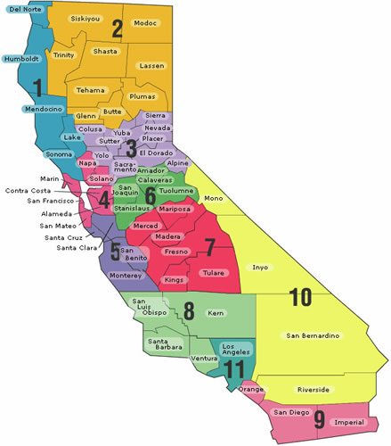
CDE FMTA Consultant Map and
Contact Information by Region
FMTA II Administrator Donna DeMartini ddemartini@cde.ca.gov | FMTA III Administrator James Johnson jamjohns@cde.ca.gov
Region 3 Kari Hudson khudson@cde.ca.gov | Region 1 Jeffrey Reyes jereyes@cde.ca.gov
El Dorado County Charter SELPA Vincent Pastorino vpastorino@cde.ca.gov | Region 2 and Region 7 D’Andrea Chapman dchapman@cde.ca.gov
Region 4 and Region 6 David Grundon dgrundon@cde.ca.gov | Region 5 Libbey Durkee Ldurkee@cde.ca.gov
Region 9 Jacqueline Stewart jstewart@cde.ca.gov | Region 8 Nicole Garibaldi ngaribaldi@cde.ca.gov
Region 11 Tamara McMillan TMcMillan@cde.ca.gov | Region 10 Vanessa Espinosa vespinosa@cde.ca.gov
LAUSD and LACOE Charters Lynne Boone Lboone@cde.ca.gov

Slide 35
Questions

Slide 36
Thank you for your time and participation.

