Slide 1
Educational Benefit Review Video Training Series
Video 1: Introduction and Legal Requirements

Slide 2
Table of Acronyms
Code of Federal Regulation (CFR)
Educational Benefit Review (EBR)
Free Appropriate Public Education (FAPE)
Individualized Education Program (IEP)
Individuals with Disabilities Education Act (IDEA)
Least Restrictive Environment (LRE)
Local Educational Agency (LEA)
United States Code (USC)

Slide 3
Outcomes
Participants will:
Be provided an overview of the EBR training video series.
Be provided an overview of how FAPE and the LRE are guiding our monitoring and technical assistance processes, and what role EBR plays in this work.
Gain a better understanding of the statutes and regulations, concerning FAPE for an EBR.

Slide 4
Educational Benefit Review Training Series
Video 1 - EBR Introduction and Legal Requirements
Video 2 – EBR Getting Started
Video 3 – Conducting the EBR, Year 1 to Year 2
Video 4 – Conducting the EBR Year 3/current IEP and Compliance Determinations
Video 5 – Summary of Files, Trends, & Submission

Slide 5
Free and Appropriate Public Education
Individuals with Disabilities Education Act:
The United States Congress Finds:
Disability is a natural part of the human experience and in no way diminishes the right of individuals to participate in or contribute to society. Improving educational results for children with disabilities is an essential element of our national policy of ensuring equality of opportunity, full participation, independent living, and economic self-sufficiency for individuals with disabilities.
20 USC § 1412 Free Appropriate Public Education (From IDEA)
FAPE is available to all children with disabilities residing in the State between the ages of 3 and 21, inclusive, including children with disabilities who have been suspended or expelled from school.

Slide 6
Statutes and Regulations
34 CFR §300.101
(a) FAPE must be available to all children residing in the State between the ages of 3 and 21, inclusive, including children with disabilities who have been suspended or expelled from school.
(c)(1) Each State must ensure that FAPE is available to any individual child with a disability who needs special education and related services, even though the child has not failed or been retained in a course or grade and is advancing from grade to grade.
California Education Code 56040
(a) Every individual with exceptional needs who is eligible to receive special education instruction and related services under this part, shall receive that instruction and those services at no cost to his or her parents or, as appropriate, to him or her. FAPE shall be available to individuals with exceptional needs.

Slide 7
Legal Support
In Endrew F. v. Douglas County School District RE-1, 137 S. Ct. 988, 999 (2017), the Supreme Court stated that a school must offer an educational program that is “reasonably calculated to enable a child to make progress appropriate in light of the child’s circumstances.”
That standard has two key parts:
Reasonably calculated; and
progress that is “appropriate in light of the child’s circumstances.”

Slide 8
Why do an Educational Benefit Review?
Refine and improve LEA practices
Provide training to staff
Identify strengths and weaknesses
Improve student outcomes

Slide 9
Educational Benefit Review
The EBR process guides school teams through the examination and comparison of specific components of the IEP to determine if the IEP is “reasonably calculated to enable a child to make progress appropriate in light of the child's circumstances.”
Specifically, the EBR reexamines present levels of performance, goals, placement, services and progress.
Student selection involves reviewing three consecutive years of a student’s IEPs, ideally starting with a review of the year in which an initial or triennial IEP was completed, and then include two subsequent years of IEP information.
The process to review these IEPs allows district teams the opportunity to investigate their district’s practices to identify areas of strength and any gaps that need to be addressed.

Slide 10
Educational Benefit Review
Guides school teams through the examination and comparison of specific components of the IEP to determine if the IEP is reasonably calculated to enable the child to make progress and receive educational benefit.
Involves reviewing three consecutive years of a student’s IEPs and must include the current operative IEP.
May start with a review of the year in which an initial or triennial IEP was completed, and then include two subsequent years of IEP information.

Slide 11
Educational Benefit
Typically, for a student with disabilities primarily in the general education classroom, an IEP reasonably calculated to result in educational benefit may be measured (in part) by:
Achieving passing marks
Advancing from grade to grade
Appropriate progress toward meeting IEP goals
Improving scores on clinical, district, and statewide assessments
Graduating with a diploma
Educational benefit must be
considered on a case-by-case basis.

Slide 12
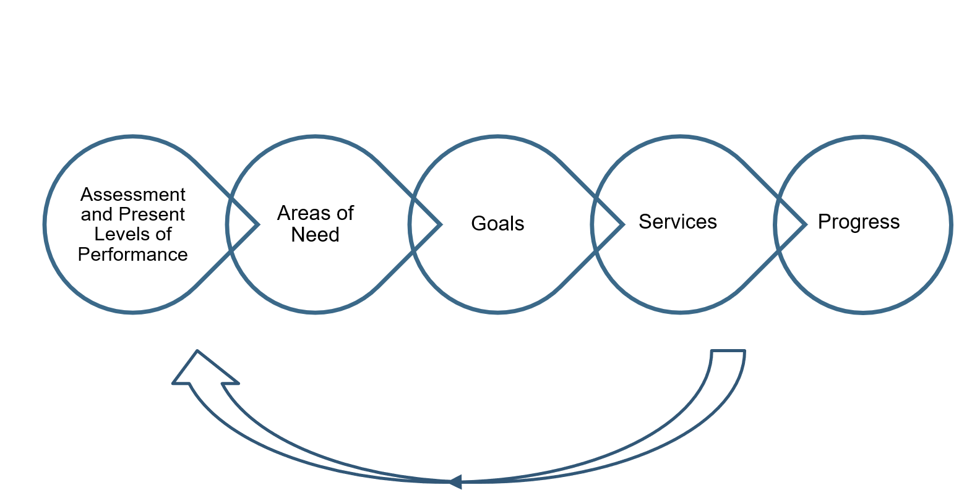
Big Picture

Slide 13
Educational Benefit Review Training Series
Video 1 - EBR Introduction and Legal Requirements
Video 2 – EBR Getting Started
Video 3 – Conducting the EBR, Year 1 to Year 2
Video 4 – Conducting the EBR Year 3/current IEP and Compliance Determinations
Video 5 – Summary of Files, Trends, & Submission

Slide 14
Thank you

