Slide 1
Compliance and Improvement
Monitoring (CIM)
Step 4–Monitoring Implementation
Targeted Monitoring
2022 and 2023 CIM Cohort LEAs
Focused Monitoring and Technical Assistance (FMTA) Units II and III

Slide 2
Reminders
This webinar will be recorded and available on the CalTAN website.
“Chat” is deactivated for this presentation. Please enter your questions in the Q and A.
All participants are muted, and we cannot unmute you.

Slide 3
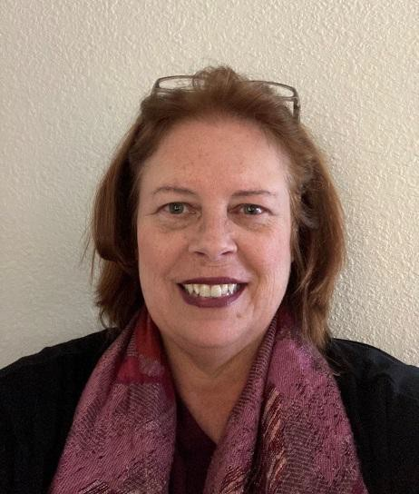

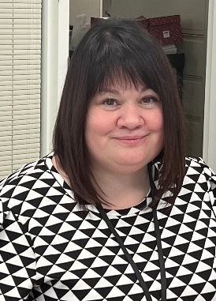

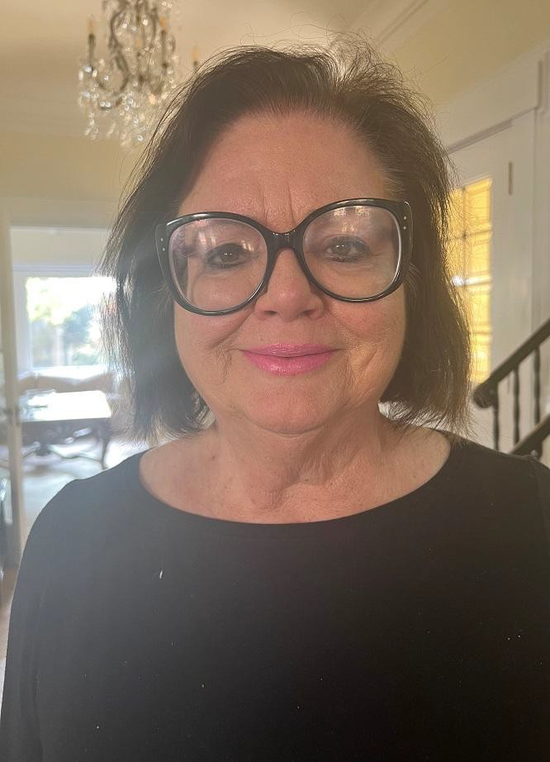


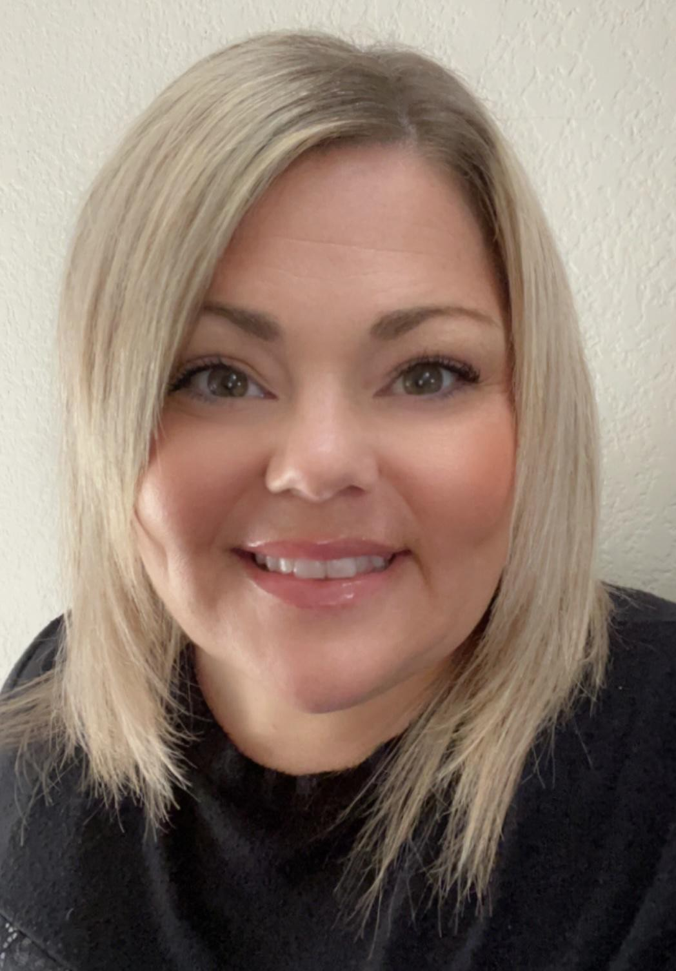
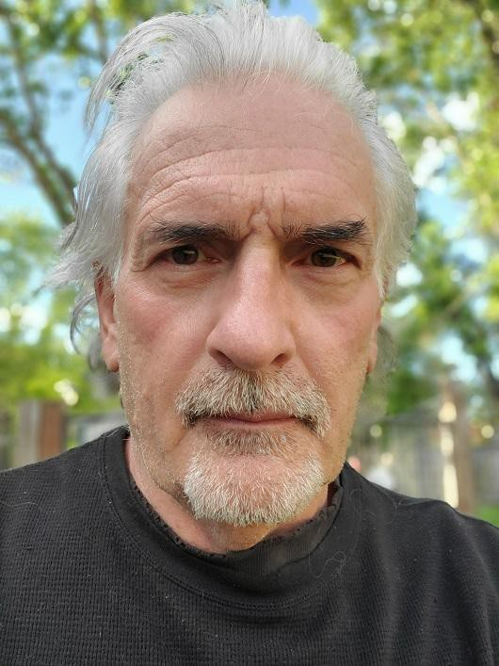
FMTA Unit II
Lynne Boone Education Programs Consultant
David Grundon
Education
Programs
Consultant
Kari Hudson
Education
Programs
Consultant
Jasmine Lee
Associate Governmental Program Analyst
Donna DeMartini
Education Administrator
Chee Lor
Office
Technician
Tamara McMillan Education Programs Consultant
Jacqueline Stewart Education Programs Assistant
Vincent Pastorino Education Programs Consultant

Slide 4



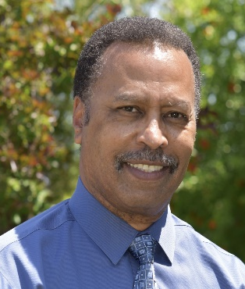

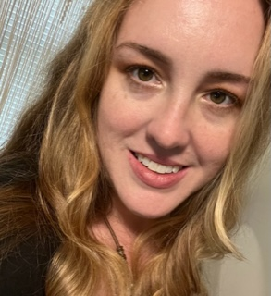
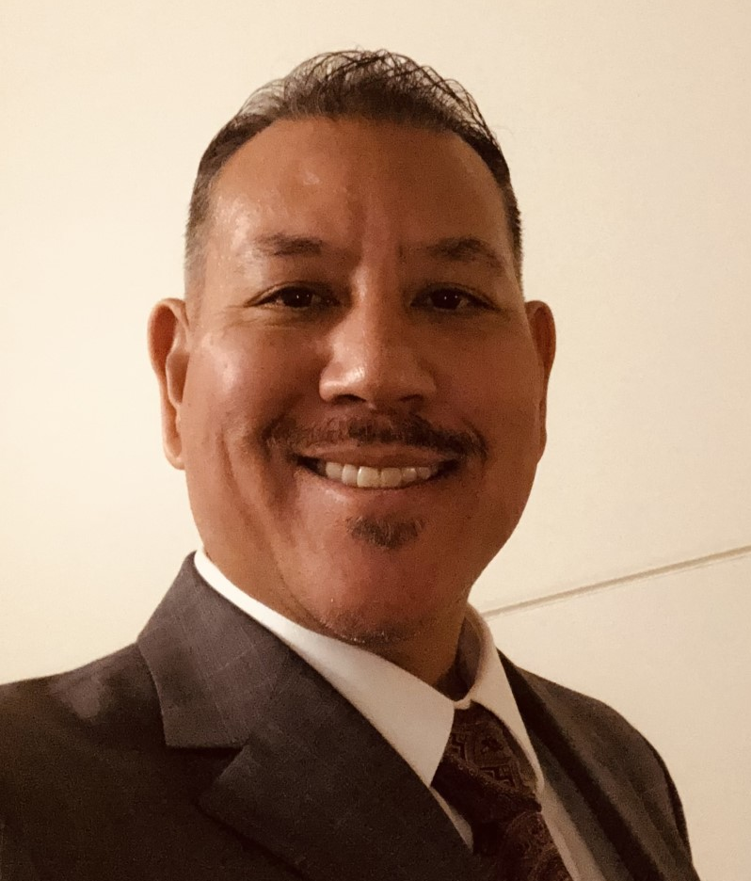
FMTA Unit III
D’Andrea Chapman Education Programs Consultant
Vanessa Espinosa
Education Programs Assistant
Jeanette Acrell-Dunn Associate Governmental Program Analyst
James T. Johnson, III
Education
Administrator
Nicole Garibaldi Education Programs Consultant
Libbey Durkee Education Programs Consultant
Jeffrey Reyes Education Programs Consultant

Slide 5
Participants
This training is for your LEA if both of the following apply…
  Identified in the March 2024 Annual Determination Letter (ADL) notification as Targeted Level 1, 2, or 3
AND
2. Developed a CIM Plan in the 2022 or 2023 monitoring year (i.e., 2022 or 2023 CIM Cohort)

Slide 6
Agenda
Participants
CIM Step 4 (Targeted)
  Purpose
  Overview
  Progress Monitoring – Data Collection
  Progress Monitoring – CIM Team Meetings
  Progress Monitoring – Documentation
  Progress Reporting
  Progress Report Form
  Disproportionality
  Timelines
Next Steps
CDE FMTA Consultant Regional Map
Questions and Answers

Slide 7
CIM Step 4 (Targeted)
Purpose
CIM Step 4—Monitoring Implementation is designed to
ensure success as the LEA implements its CIM Plan.

Slide 8
CIM Step 4 (Targeted)
Overview
  Each CIM Step 4 LEA identified as Targeted Level 1, 2, or 3 in the March 2024 ADL notification will monitor the implementation of its existing CIM Plan. This will include analyzing progress and revising the CIM Plan as appropriate
  Targeted Level 1 LEAs do not need to report to SELPA or the CDE
  Targeted Level 2 LEAs will report on the above to the SELPA
  Targeted Level 3 LEAs will report on the above to the CDE
  Targeted LEAs identified as Disproportionate in the data sheets will need to complete a Disproportionality Review.

Slide 9
CIM Step 4 (Targeted)
Overview
STEP 4—Monitoring Implementation |  |  | Targeted Level 3
DIFFERENTIATED MONITORING LEVEL | Targeted Level 1 | Targeted Level 2 | Targeted Level 3
PROGRESS MONITORING | Required | Required | Required
PROGRESS REPORTING | Optional | Required | Required
PROGRESS REPORTS SUBMITTED TO | N/A | SELPA | CDE
Policies, Procedures, and Practices Review (Disproportionality version) | Required for all LEAs identified as Disproportionate in the data information linked to the 2024 ADL notification

Slide 10
CIM Step 4 (Targeted)
Progress Monitoring – Data Collection
As a review, the CIM Plan includes, in addition to other information, the following:
  A description of High Leverage Strategies and Expected Measurable Outcomes
  A list of Activities supporting each High Leverage Strategy, including data sources/methods for evaluating progress, as appropriate
Accordingly, the CIM Team must identify and implement a data-gathering system to provide the team with up-to-date information for frequent evaluation of the following:
  The effectiveness of each High Leverage Strategy listed in the CIM Plan
  The status and effectiveness of each supporting Activity

Slide 11
CIM Step 4 (Targeted)
Progress Monitoring – CIM Team Meetings
The CIM Team must meet periodically to identify, review, and/or address the following:
  Data regarding movement toward the Expected Measurable Outcome of each High Leverage Strategy listed on the CIM Plan, including data regarding student outcomes, as applicable
  Data regarding progress on the supporting Activities for each High Leverage Strategy, including data regarding student outcomes, as applicable
  Input, if any, received from families/parents of students with disabilities that indicates whether the CIM Plan is positively affecting student programs and/or outcomes
  Accomplishments, discoveries, and challenges of implementing the CIM Plan
  Additional supports and/or revisions needed to address challenges and continue progress on the CIM Plan

Slide 12
CIM Step 4 (Targeted)
Progress Monitoring – Documentation
Each Targeted Level 1, 2, and 3 LEA must create and maintain organized documentation of its CIM Plan implementation and monitoring.
Documentation maintained by the LEA should include, but not be limited to, the following:
  CIM Team meeting notes
  Data collected for the High Leverage Strategies and Activities
  Copies of written communication pertinent to the CIM process, to or from the CDE
  A complete version of the current CIM Plan, including updates, integrated into a single document
  (The LEA, SELPA, or CDE should not have to identify, find, and isolate pertinent portions of multiple documents to determine the current version of the LEA’s CIM Plan.)
  For purposes of reference or comparison, any earlier working versions of the CIM Plan

Slide 13
CIM Step 4 (Targeted)
Progress Monitoring – Documentation
Documentation tips:
For Targeted Level 1, 2, and 3 LEAs – be prepared that the SELPA and CDE may request supporting documentation at any time during the CIM process
Within the supporting documentation, include notes explaining the CIM Team’s data-based rationale for any revisions to the CIM Plan (This will be helpful to the CIM Team if the composition of the team changes.)
For all Targeted Level LEAs – keep backup copies of any required CIM documentation submitted to the CDE either directly or via an online program or database

Slide 14
CIM Step 4 (Targeted)
Progress Reporting
Targeted Level 3 LEAs
  Complete and submit the mandatory 2024 Progress Report Form to the CDE Consultant via email at the required semiannual intervals, with a copy emailed to TargetedMonitoring@CDE.ca.gov.
Targeted 2 LEAs
  Submit Progress Reports to the SELPA at the required semiannual intervals
  The SELPA will prescribe the required Progress Report format. However, the content must include all information required on the 2024 Progress Report Form mandatory for Targeted Level 3 LEAs
All Targeted LEAs
  Be prepared to produce documentation corroborating Progress Monitoring and/or the content of the Progress Reports, as applicable, if the SELPA or the CDE requests such documentation
  The mandatory version of the 2024 Progress Report Form is posted on the CalTAN website

Slide 15
CIM Step 4 (Targeted)
2024 CIM Progress Report Form (page 1)
Submission and Due Dates: Local Educational Agencies (LEAs) currently identified as Intensive or Targeted Level 3 must submit the completed and signed progress reports by email to the assigned Focused Monitoring and Technical Assistance (FMTA) Consultant, with a copy emailed to either IntensiveMonitoring@cde.ca.gov or TargetedMonitoring@cde.ca.gov, as appropriate. Progress reports are due by the corresponding date listed below. The CDE will review the progress report and provide feedback to the LEA as appropriate.
Please check the appropriate box: Intensive Targeted Level:_________
Complete the following:
LEA Name: _______________________________________________________
LEA Contact: ______________________________________________________
SELPA Name: _____________________________________________________
CIM Cohort Year*: __________________
*NOTE: CIM Cohort Year is determined by submission date: 2022 Cohort submitted CIM Plans in November 2022; 2023 Cohort submitted CIM Plans in November 2023.
Check the appropriate box for this Progress Report (Intensive LEAs are required to submit quarterly progress reports for all listed dates. Targeted Level 3 LEAs are required to submit semi-annual progress reports as shown in bold.)
_____ April 10, 2024: Intensive [January 1 – March 31, 2024]
_____ July 10, 2024: Targeted [January 1 – June 30, 2024] and Intensive [April 1 – June 30, 2024]
_____ October 10, 2024: Intensive [July 1 – September 30, 2024]
_____ January 10, 2025: Targeted [July 1 – December 31, 2024] and Intensive [October 1 – December 31, 2024] NOTE: This is the 2022 CIM Cohort final progress report.

Slide 16
CIM Step 4 (Targeted)
2024 CIM Progress Report Form (page 2)
Implementation Reflection Prompts: Reflect on each of the implementation prompts below.
1. Briefly describe your LEA’s most significant accomplishment or discovery this reporting period in regard to your CIM Plan.
2. Briefly describe any significant challenges you encountered during this reporting period and how you worked through them.
3. How has your team reviewed/revised your plan to address any challenges your team is facing?
4. Are there any additional supports you need to continue progress on your plan? If yes, please describe.
5. What input, if any, have you received from families/parents of students with disabilities that indicates whether the CIM Plan is positively affecting student programs and/or outcomes?

Slide 17
2024 CIM Progress
Report Form
(page 3)

Slide 18
2024 CIM Progress
Report Form
(page 4)

Slide 19
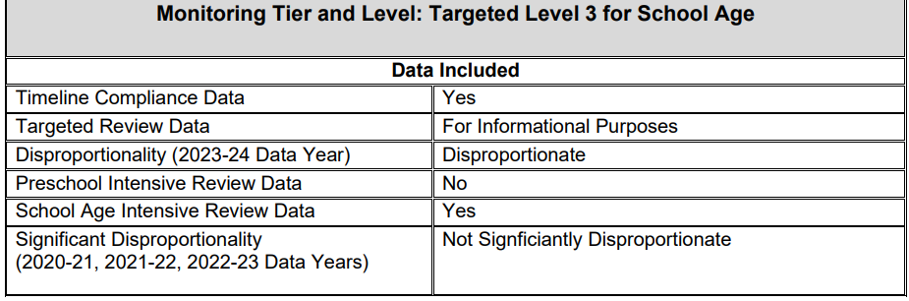
CIM Step 4 (Targeted)
Disproportionality
Targeted Monitoring LEAs that begin the 2024 monitoring year in CIM Step 4 will have already completed a Policies, Procedures, and Practices Review (PPPR) in 2022 or 2023 as part of Step 1 in the CIM process...
  However, if the data sheets linked to the March 2024 ADL notification identify the Step 4 LEA as Disproportionate, the LEA must participate in the version of the PPPR that covers Disproportionality.
The PPPR- Disproportionality Review process will occur in SECMS. A pre-recorded PPPR training will be available early April on the CalTAN website
LEAs completing a Disproportionality Review in Step 4 will not report a summarization of findings to the SELPA or CDE. Instead, they will consider information learned from the Disproportionality Review when developing their Step 4 Progress Reports

Slide 20
CIM Step 4 (Targeted)
Timelines
Progress Monitoring for the 2022 and 2023 CIM Cohorts
  Progress Monitoring by each Targeted Level 1, 2, or 3 LEA is a required, ongoing activity throughout the two-year implementation phase of the LEA’s CIM Plan
Progress Reporting for the 2022 and 2023 CIM Cohorts
  Targeted Level 1 LEAs have no Progress Reporting requirement
  Targeted Level 2 LEAs must submit completed Progress Reports to the SELPA. The due dates for the 2024 monitoring year are July 10, 2024 , and January 10, 2025
  Targeted Level 3 LEAS must submit completed Progress Reports on the mandatory 2024 Progress Report Form and email those reports to the Targeted FMTA Consultant with a copy to TargetedMonitoring@cde.ca.gov. The due dates are July 10, 2024, and January 10, 2025
  Assurances from SELPA for Targeted Level 1 and 2 LEAs will be required and due December 17, 2024
PPPR- Disproportionality Review
  The Disproportionality Review will commence upon the LEA’s receipt of Student Lists from the FMTA Consultant. The LEA will be able to begin the review once they receive a PIN email from SECMS. The due date for completion of the LEA’s self-review portion in SECMS is June 30, 2024

Slide 21
Next Steps
All Targeted LEAs – promptly email an updated CIM Team contact list to your assigned FMTA Consultant
Continue with your CIM Team meetings as you implement your CIM Plan
Review the March 2024 ADL notification to learn the LEA’s monitoring tier (Targeted or Intensive) and Level (1, 2, or 3)
Review any data sheets linked to the ADL notification
If identified as Disproportionate in the ADL’s linked data sheets, watch the pre-recorded PPPR training, available early April
Review training materials and resources posted on the CalTAN website
Targeted Level 2 LEAs – check with your SELPA regarding Progress Report format requirements. (The CDE highly recommends that the SELPA instructs its Targeted Level 2 LEAs to use the same 2024 CIM Progress Report Form that is mandatory for Targeted Level 3 LEAs. This will ensure consistency from year-to-year as monitoring tiers and levels potentially change for an LEA.)

Slide 22
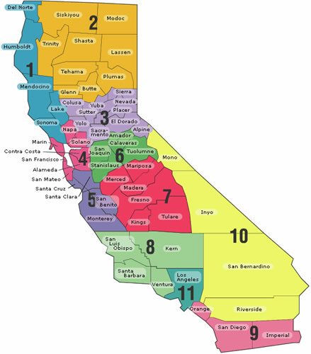
CDE FMTA Consultant Map and
Contact Information by Region
FMTA II Administrator Donna DeMartini ddemartini@cde.ca.gov | FMTA III Administrator James Johnson jamjohns@cde.ca.gov
Region 3 Kari Hudson khudson@cde.ca.gov | Region 1 Jeffrey Reyes jereyes@cde.ca.gov
El Dorado County Charter SELPA Vincent Pastorino vpastorino@cde.ca.gov | Region 2 and Region 7 D’Andrea Chapman dchapman@cde.ca.gov
Region 4 and Region 6 David Grundon dgrundon@cde.ca.gov | Region 5 Libbey Durkee Ldurkee@cde.ca.gov
Region 9 Jacqueline Stewart jstewart@cde.ca.gov | Region 8 Nicole Garibaldi ngaribaldi@cde.ca.gov
Region 11 Tamara McMillan TMcMillan@cde.ca.gov | Region 10 Vanessa Espinosa vespinosa@cde.ca.gov
LAUSD Charters and LACOE Charters Lynne Boone Lboone@cde.ca.gov

Slide 23

Questions

Slide 24
Thank you for your time and participation.

